Slide 1
Workflow pitch
Door: Ruben Versigny, Youri Vos en Pien van Vugt
Datum: 25-03-2021
Vak: NGS

Slide 2
Content table
Workflow
Assembly
Species
Resistance genes in the bacteria

Slide 3
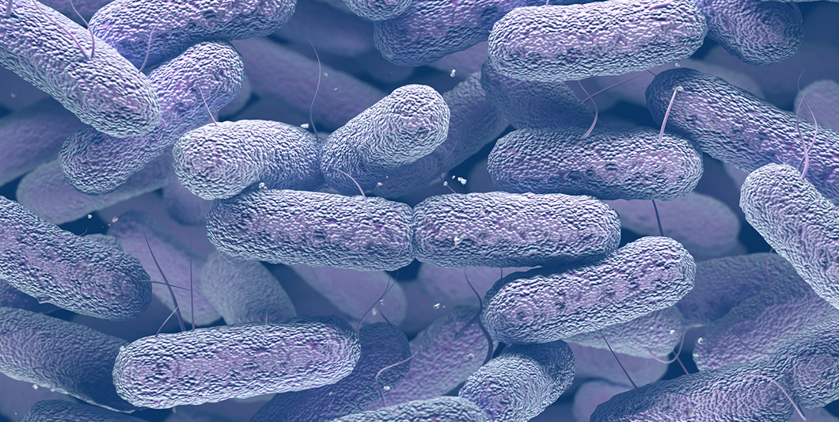
Klebsiella pneumonia

Slide 4
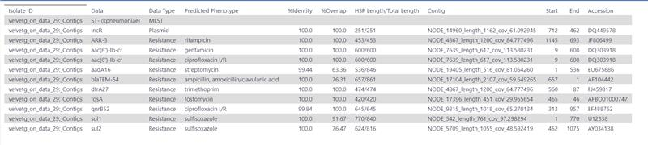
Staramr

Slide 5
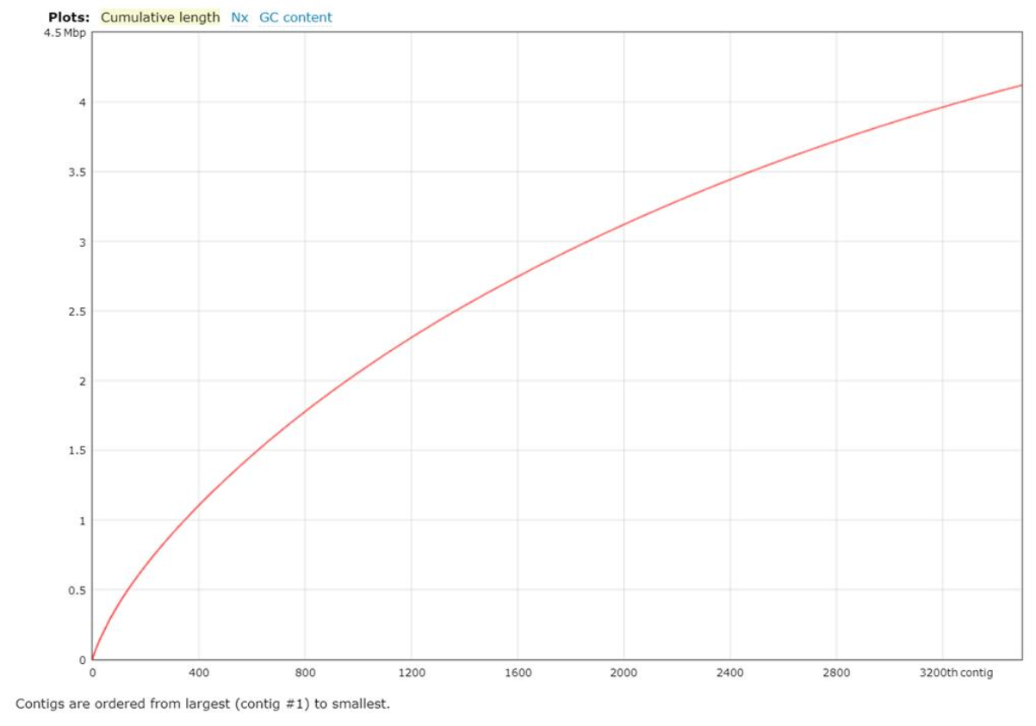
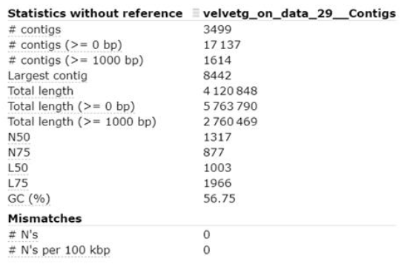
Quast

